Slide 1

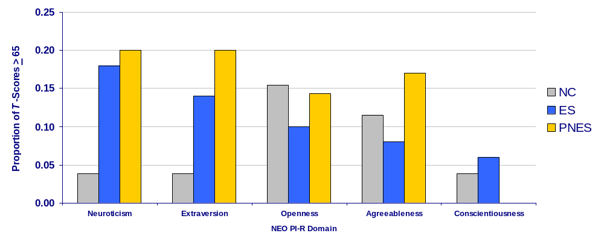
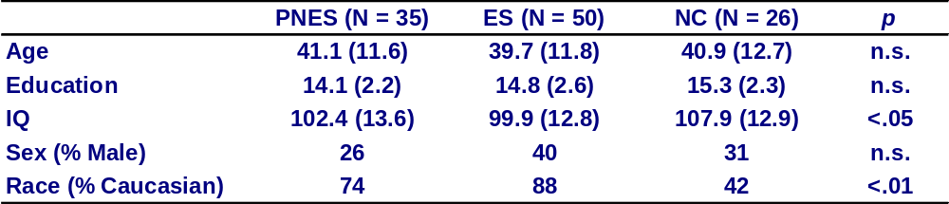
Personality Traits in Patients with Psychogenic Nonepileptic Seizures
JungGeum Im¹, S. Marc Testa², Ronald P. Lesser^{3,4}, Gregory L. Krauss³, Mollie Sprung³, & Jason Brandt^{2,3}
Department of Psychology, Loyola College in Maryland¹
Departments of Psychiatry and Behavioral Sciences, ² Neurology³ and Neurosurgery,⁴ Johns Hopkins University School of Medicine, Baltimore, Maryland
INTRODUCTION
Psychogenic non-epileptic seizures (PNES) are behavioral episodes that resemble epileptic seizures (ES), but are not associated with epileptiform activity on EEG.¹
PNES often form the core of psychiatric conditions that are diagnosed variably as somatization, conversion, or dissociative disorders.
Despite the high incidence of PNES (about 4 per 100,000 per year in the United States), effective treatment is lacking and therapeutic targets are needed.
Although patients with PNES have been described as having elevated neuroticism² and extraversion,³ previous studies have not:
  (1) compared the personality traits of PNES to a matched group of neuropsychiatrically normal controls or
  (2) explored other major personality domains such as openness, agreeableness, and conscientiousness.
We sought to compare five domains of personality (neuroticism, extraversion, openness, agreeableness, and conscientiousness) across three groups (PNES, ES, and NC).
Our secondary goal is to compare the individual facets of each of the five personality domains.
METHODS
Participants
Inpatients between 18 and 65 years-old without intellectual impairment were recruited from the Johns Hopkins Hospital epilepsy monitoring unit (EMU). All patient participants were approached to participate in this study shortly after admission, but prior to diagnosis.
All patients revceived a definitive diagnosis of ES or PNES (but not both) based on prolonged video/EEG monitoring by a board certified neurologist with expertise in EEG and epilepsy.
Normal control (NC) participants were recruited from the hospital community and had no history of major psychiatric illness, substance abuse or dependence in the prior 12 months, or central nervous system dysfunction.
To evaluate the existence of extreme domain-level traits by group, the proportion of participants with T-Scores > 65 were calculated for each group. We then tested the differences between proportions, first comparing PNES to NC, and then PNES to ES.
To compare facets within each personality domain, five MANOVAs were conducted. Each MANOVA used facet-specific traits as the dependent variables and participant group (PNES, ES, and NC) served as the between-groups factor.
Follow-up analyses included planned pairwise comparisons (PNES vs. NC and PNES vs. ES) for domain and facet level scores.
RESULTS
The domain-level MANOVA was significant (Hotelling’s T² (10, 206) = 2.65, p < .01). This effect was due mainly to lower Openness in ES than in PNES or NC.
Despite the absence of differences related to group means for each domain, a greater proportion of the PNES than NC group had T-scores > 65 on Neuroticism (z=-1.85, p<.05) and Extraversion (z=-1.85, p<.05). The proportion of ES and PNES with T-scores > 65 did not differ for any domain. See Figure.
Facet-specific MANOVA revealed a significant effects for:
  Neuroticism facets (Hotelling’s T² (12, 204) = 1.81, p < .05) due to higher “Vulnerability” (p<.05) in PNES than NC.
  Agreeableness facets (Hotelling’s T² (12, 204) = 2.08, p < .03) due to low “Tender-mindedness” (p=.01) in ES than PNES and NC and lower “Compliance” (p=.04) in PNES than NC.
Domain level NEO PI-R Scores (Proportion of T-Score for each group > 65)
Group Characteristics
CONCLUSIONS
No evidence was found for differences between PNES patients and either patients with epilepsy or normal subjects on major domains of adult personality.
Even after close inspection of facet-level traits, very few differences emerged between groups.
However, when a greater proportion of patients with PNES had more extreme (i.e., T-Score > 65) Neuroticism and Extraversion scores than the NC group.
Although the domain specific T-Scores for the PNES group were all close to 50, extreme personality traits appear to exist at a greater frequency in PNES than in NC. These results support the notion that the PNES population is heterogeneous and that personality vulnerabilities may be present in some, but not all individuals with PNES.
REFERENCES
Gates, J.R. (2000). Editorial: Nonepileptic seizures: Time for progress. Epilepsy & Behavior 1, 2-6.
Crager, D.E., Berry, D. T.R., Schmitt, F. A., & Fakhoury, T. A. (2005) Cluster analysis of normal personality traits in patients with psychogenic nonepileptic seizures. Epilepsy & Behavior, 6, 593-600.
Slavney, P.R. (1990). Perspectives on “Hysteria”. The Johns Hopkins University Press.78-79.
Costa, P.T. & McCrae R.R. (1992). NEO-PI-R professional manual. Odessa, FL: Psychological Assessment Resources, Inc.
Procedures
All participants completed background information and self-report questionnaires, including the NEO-PI-R⁴ to assess normal personality traits. All raw scores are transformed to T-scores (M=50; SD=10) based on normative data.
Statistical Analysis
All five personality domain scores (Neuroticism, Extraversion, Openness, Agreeableness, and Conscientiousness) were entered into a multivariate analyses of variance (MANOVA). Participant group (PNES, ES, and HC) served as the between-groups factor.

